Slide 1
Welcome to CS4222 PSLG!
With Robert and Jakub

Slide 2

Java LinkedLists
A collection which can contain many objects of the same type​
Stores its items in "containers." The list has a link to the first container and each container has a link to the next container in the list​
To create LinkedList:​
LinkedList<String> cars = new LinkedList<String>();​
cars.add("Volvo");​
cars.add("BMW");​
cars.add("Ford");​
cars.add("Mazda");​
System.out.println(cars);​

Slide 3
Problem 1
Write a Java method to insert a new element with a given value at the beginning of a linked list

Slide 4
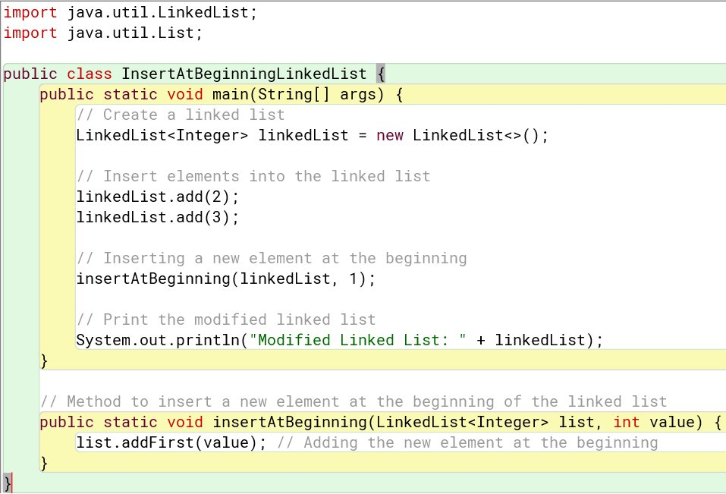
Answer:

Slide 5
Problem 2
Implement a Java method to insert a new element with a given value at the end of a linked list

Slide 6
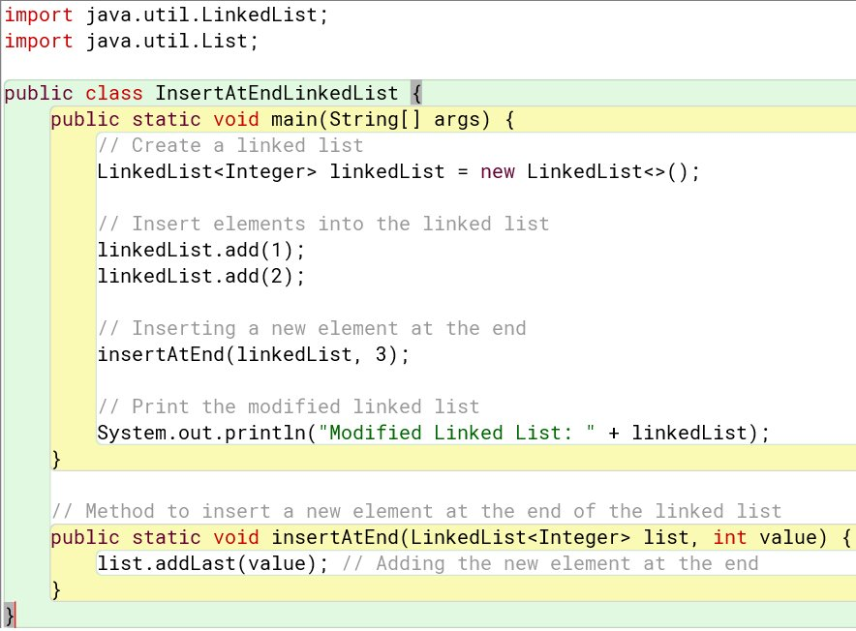
Answer:

Slide 7
Problem 3
Create a Java function to delete the first occurrence of an element with a specific value from a linked list

Slide 8
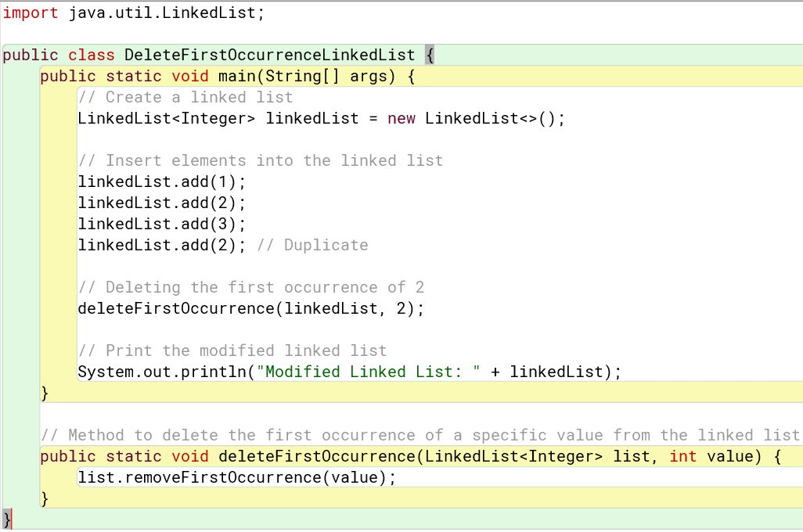
Answer:

Slide 9
Problem 4
Implement a Java function to find the middle element of a linked list

Slide 10
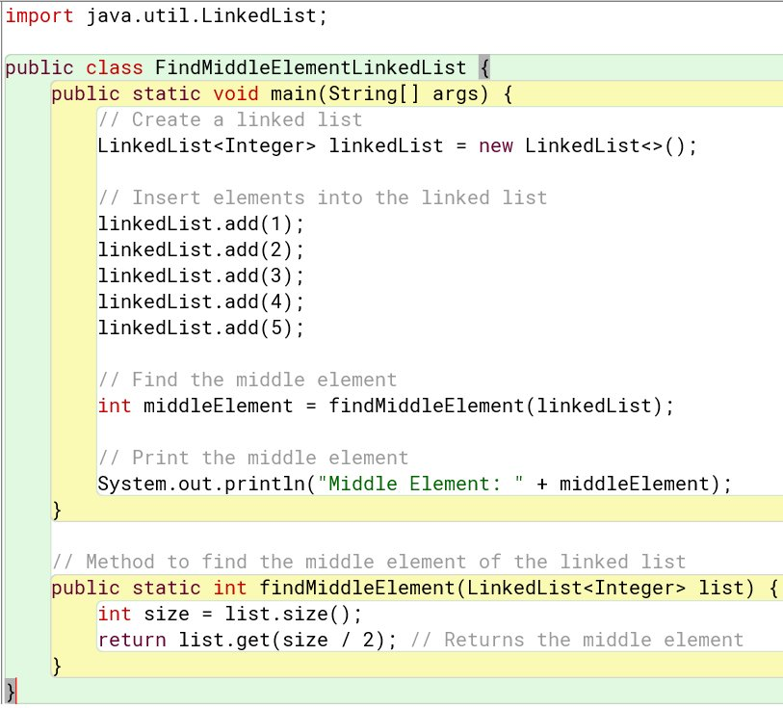
Answer:

Slide 11
Problem 5
Create a function to check if a linked list is a palindrome.

Slide 12
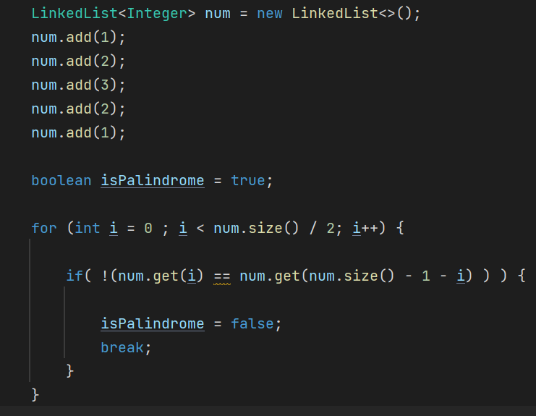
Answer:

Slide 13

Thank you for coming!

